Slide 1
GIT UNDOING AND BACKTRACKING
Created for Microsoft / TNT

Slide 2
Learning Objectives
TNTs will understand what can go wrong with Git
TNTs will learn strategies for fixing things with Git
TNTs will practice strategies for resolving issues with Git
TNTs will practice with Live Share

Slide 3
PART 1 PRACTICING EXPLAINING GIT
15 minutes

Slide 4
The commands so far
git config --global user.name "FIRST_NAME LAST_NAME"
git config --global user.email "MY_NAME@example.com"
git init
git status
git add .
git commit file -m "message"
git log or git log –-oneline
git push
git pull
git branch branchname
git checkout branchname
Files/directories
.git
.gitignore

Slide 5
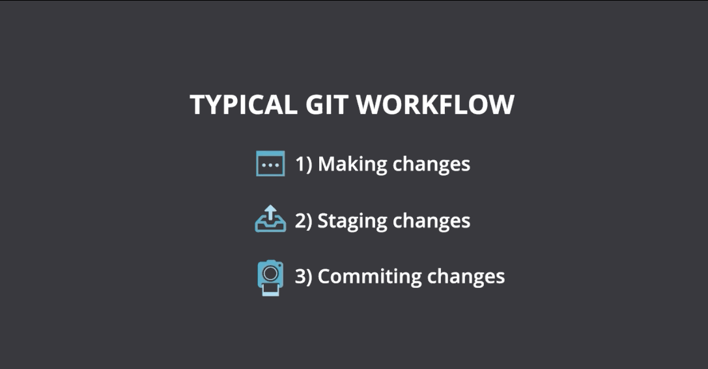

Slide 6
Things to know
Be sure you can answer the following questions:
What is Git?
What are some advantages of using Git?
How can you create a repository in Git?
What is `git add` used for?
What is a commit message?
Example of two-part answer – definition-like and use-case
Question: What is the difference between Git and GitHub?
Git is a version control system that manages and tracks source code history. GitHub is a cloud-based hosting services for managing Git Repositories.
Git can be used with local repositories and other cloud hosting repositories like GitHub, GitLab or BitBucket. The cloud hosting services support Git and introduce more features that support team development life cycle, with a graphical user interface, control, and task-management tools.

Slide 7
PART 2 TACTICS FOR BACKTRACKING AND UNDOING WITH GIT
30 minutes

Slide 8
Scenario 1 – Correct (amend) the last commit message
touch file.html
touch otherfile.html
git add .
git commit –m commit “file.html“
git log --oneline
[Do some git status, git add here… These staging things will be added to the previous commit]
git commit --amend -m “commit file.html“
git log --oneline

Slide 9
Scenario 2a – Recover a deleted file that was not committed
You deleted a file, and immediately realized it was a mistake? You did not do a commit yet
rm file.html
ls –al
git status
git checkout file.html
git status
ls -al
Is the file back?

Slide 10
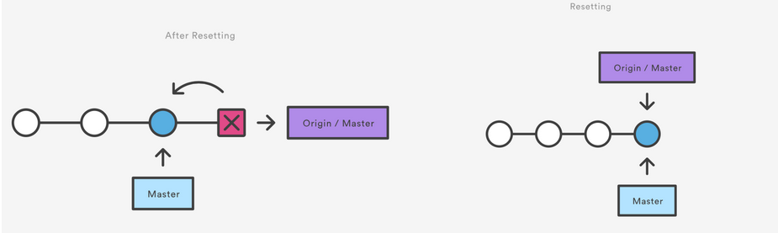
Scenario 2b – Recover a deleted file that was committed
You made a commit deleting a file, but then realized you wanted to keep the file around after all?
rm file.html
git add .
git commit –m “remove file.html”
ls -al
git log --oneline
git reset --hard HEAD~1
ls -al
git log –oneline
Is the file back? Is history preserved?
Notes:
If you use git reset HEAD~1 you need to then use checkout
does not keep the history

Slide 11
Scenario 2c – Recover a deleted file after more commits
If you deleted a file, committed, then continued work and did more commits, only to find that deleting the file was a mistake
Find the last commit where the file was still present or the commit that delete the file
git log -- <filename>
git checkout <commit hash> -- <filename>
From the last commit where the file was present
git checkout <commit hash>~1 -- <filename>
One commit before
Is the file back?
Notes:
If you use git reset HEAD~1 you need to then use checkout

Slide 12
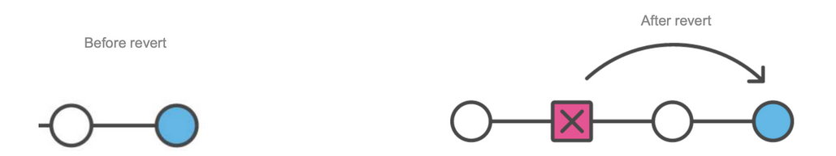
Scenario 3 – Reverting a commit
Sometimes you just need to go back to a previous version!
Going back to the version before the last commit
git revert HEAD
Vim or an editor opens to put a message
Same as git reset --hard HEAD^
Revert keeps the history but reset delete the whole history. It will not be in the log anymore

Slide 13
PART 3 LIVE SHARE AND TODOLIST
15 minutes
Try out LiveShare

